Slide 1
Sarcasm Detection
Vaibhav Chandra (190001065)

Slide 2
Problem Statement
Using various NLP algorithms to extract meaning from corpuses of words has been the norm for many years now. But with the increase in usage of sarcasm in social medias nowadays, new algorithms must be made or changes must be made to the existing ones to accommodate this extra dimension of meaning that sarcasm adds to the words. Our job is, given a corpus of words, classify it as either sarcastic or non-sarcastic.
Let us see what is sarcasm first…..

Slide 3
What is Sarcasm?
“The use of remarks that clearly mean the opposite of what they say, made in order to hurt someone's feelings or to criticize something in a humorous way” - Cambridge Dictionary
Use of words in such a way that the opposite of the apparent meaning is implied. For example:-
“WOW! Good Job!”
This might look like a complimentary sentence at first, but is often used by people to imply that a mistake has been done. Sometimes even human brain fails to recognize sarcasm in words. This alone indicates how complicated and important sarcasm detection actually is.
“This is the best day of my life!” , “This looks easy!” are some other examples of sarcasm.

Slide 4
Features of corpus
There are many ways to tackle sarcasm detection problem. There are many features in corpus that can help in the classification like:
Lexical features:- We can use the nouns, phrases in the corpus to classify. For example, it may be more likely that a sentence that contains the phrase “well done!” might be sarcastic.
Stemmed features:- go, going, gone are different words but they have the same stem word “go”. We can use this fact to decrease the size of our vocabulary and increase the performance of our algorithm substantially.
Pragmatic features:- The above two features rely on words. Another type of features being used extensively nowadays is pragmatic. This uses emojis (😂) and emoticons ( :) ) to detect the nature of sentence. This is an approach we will use ahead.

Slide 5
Algorithms
Some algorithms that have been used past to successfully detect sarcasm are follow (decreasing order of use) :
Support Vector Machines (Used most widely)
Logistic Regression
Naive Bayes
Random Forest

Slide 6
Our Approach
We will be using the latest approach stated, using emojis to detect sarcasm. Since we have a sequence of words, we will have to use recurrent neural network ( RNN ) for this job. Another thing to notice here is that for each word, we not only rely on the words before it but also on the words following it to make a decision that will the classification later on. Keeping this in mind, unidirectional won’t suffice and we will use Bi-directional Recurrent Neural Network. Size of our vocabulary can reach very high magnitudes. Therefore, we will use word embedding before inputting into the RNN. There are many such word embedding algos available.

Slide 7
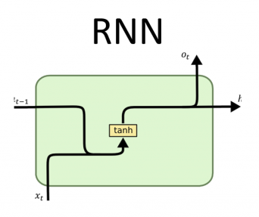
Type of RNN unit
There are 3 types of RNN unit that can be used for this purpose:-
Simple RNN :-

Slide 8
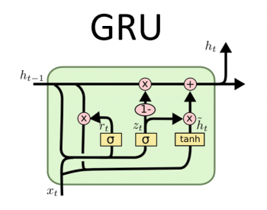
Types of Unit
2.) Gated Recurrent Unit:-
Input from previous unit and hidden state are merged into one input. Uses Update gate to decide whether to remember past word or forget.

Slide 9
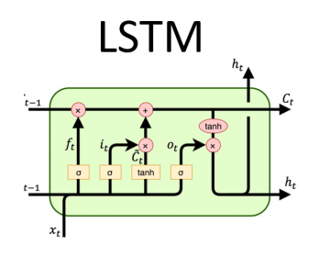
Types of Unit
3.) Long Short Term Memory :-
Input from previous unit and hidden states are separate. Uses update gate and forget gate to decide.

Slide 10
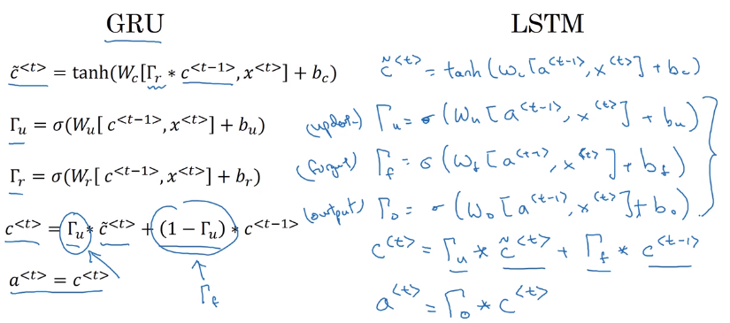
Points to Consider
A word at 3rd position might affect the output from the unit while analysing the 10th word. For this reason, we cannot rely on simple RNN unity to get us high accuracy. GRU and LSTM can remember data from the past. LSTM came much earlier than GRU and is considerably more complicated than GRU. Either of these units will work for our model.

Slide 11
Word & Emoji Embedding
The traditional one-hot vector has two shortcomings.
Size:- Its size if equal to the size of the vocabulary. This can prove to be a problem for larger vocabularies.
Relations:- Suppose we have two words, apple and orange. These two words have common properties that they are both fruits, grow on trees, etc. One-hot vector fails to represent this information.
Due to these reasons, word embedding becomes necessary for higher accuracy. Emojis also have a similar justification for embedding.

Slide 12
Flow of the Algorithm
Embedding:- Convert input words and emojis to their corresponding embedded vectors.
RNN:- Feed the vectors into the Bi-directional RNN to get a prediction for each word at each time step.
Make v:- Make context vector v as a linear combination of the outputs of the RNN units.
Activation:- Finally use an activation function like sigmoid or ReLU to classify the corpus as sarcastic or non-sarcastic.

